Slide 1
MIG Welding
By: James Zartman

Slide 2
History
Also known as Gas Metal Arc (GMA) or Gas Metal Arc Welding (GMAW)
IN 1940 the Gas Shielded Metal Arc Welding was developed by Hobart and Devers at Battelle Memorial Institute
IN 1948 the Air reduction company developed the inert gas metal arc welding process (MIG)
In 1953 the GMAW process was modified to use carbon dioxide
It requires 3 things
  Electricity-to produce heat
  Electrode- to fill the joint
  Gas- to protect the weld from air

Slide 3
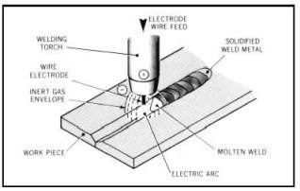
History continued
An electric arc is established between work piece and consumable bare wire electrode
Arc continuously melts wire as its fed into weld puddle
The weld metal is shielded from atmosphere by flow of inert gas or gas mixture
Shielding gases are used to prevent contamination
  Caused by nitrogen, oxygen, and water vapor
  Can cause cracking in welds, or cause them to be porous.

Slide 4
Where is it used
MIG welding process can be used to weld almost any kind of metal.
  Carbon Steel is the best option
3 most common Metals welded with MIG
  Carbon Steel
  Stainless Steel
  Aluminum- requires special feeder because wire is so soft

Slide 5
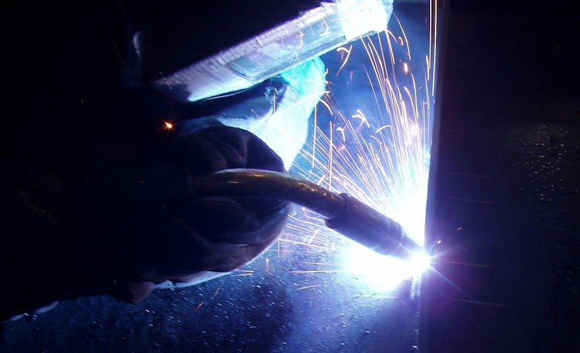
Why MIG Welding?
Fast process
Cost efficient
Produce long welds with less restarts
Excellent for spot and Tack welds
Clean welds with little to no smoke
Not much skill needed

Slide 6
REsources
http://www.gowelding.org/welding/mig-gmaw/
http://www.weldinghistory.org/whfolder/folder/wh1950.html
http://www.weldinghistory.org/whfolder/folder/wh1900.html
http://www.esabna.com/euweb/mig_handbook/592mig1_1.htm

